Slide 1

Informed Search

Slide 2

Strategies that know whether one non- goal state is “more promising” than another are called informed search or heuristic search strategies
Informed Search
Heuristics
Greedy Search
A* Search

Slide 3

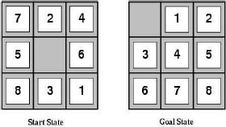
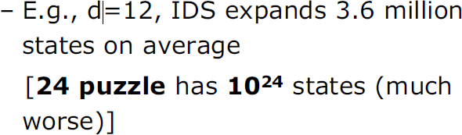

Slide 4
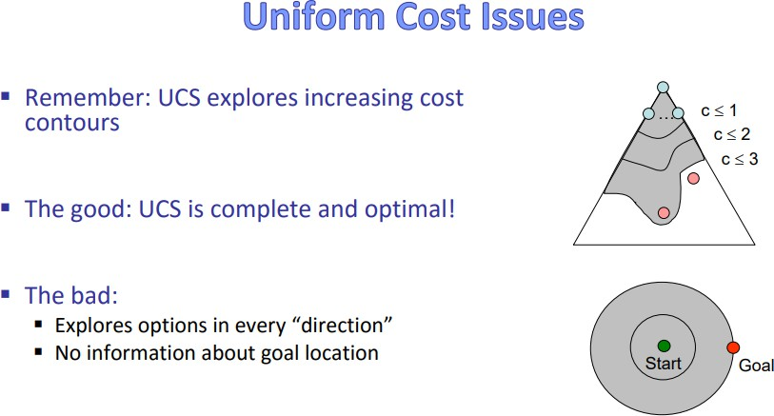

Slide 5
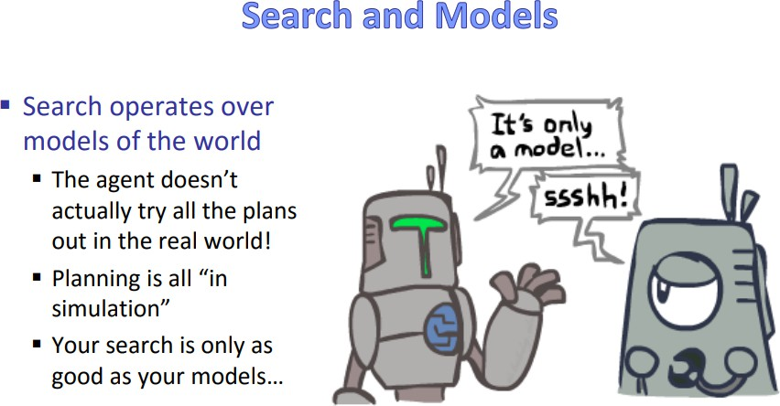

Slide 6
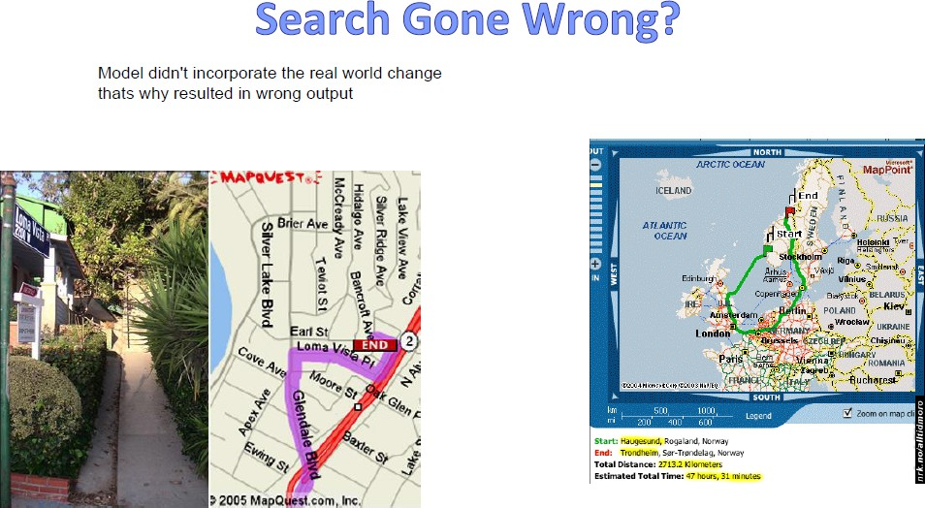

Slide 7

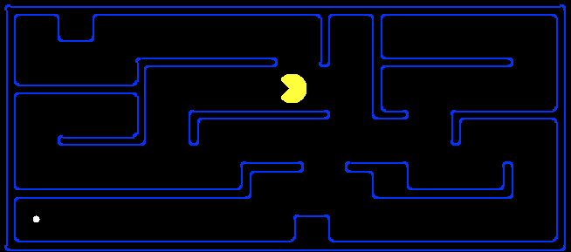
A heuristic is:
A function that estimates how close a state is to a goal
Designed for a particular search problem
h(n) = estimated cost of the cheapest path from the state at node n to a goal state.
Examples: Manhattan distance, Euclidean distance for pathing
10
5
11.2

Slide 8
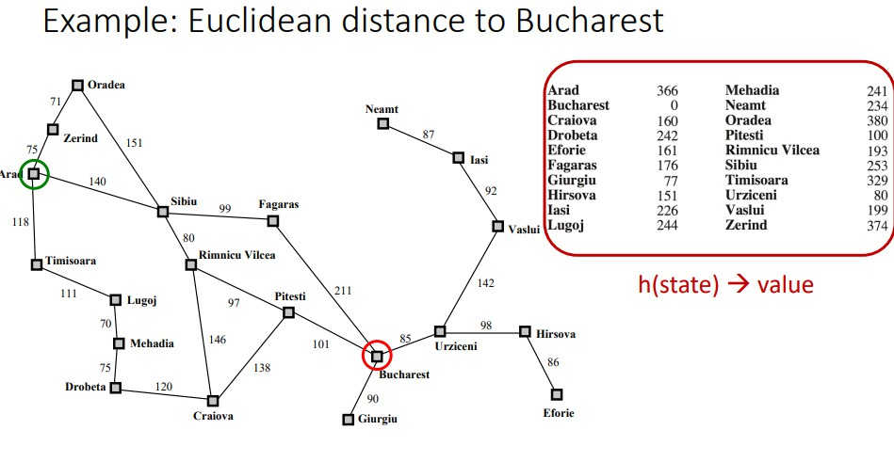
Lookup table containing distance of bucharest to all cities so in this case Lookup table is the Heuristic function

Slide 9
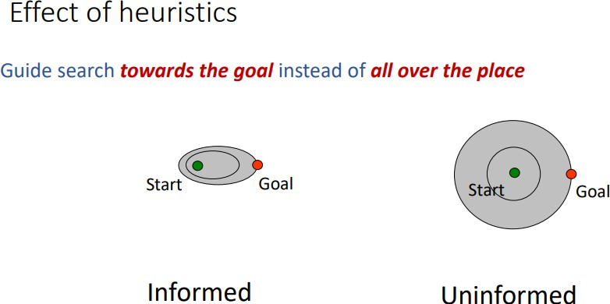

Slide 10




Flip Position
Cost: Number of pancakes flipped

Slide 11

For this state space what could be a good heuristic Function?

Slide 12
Heuristic: the number (id) of the largest pancake that is still out of place
3
h(x)
4
3
4
3
0
4
4
3
4
4
2
3

Slide 13


Slide 14
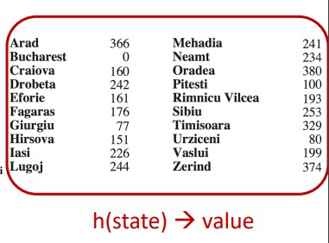
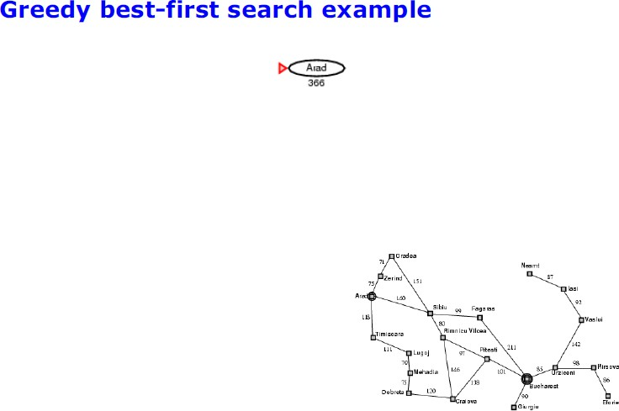

Slide 15
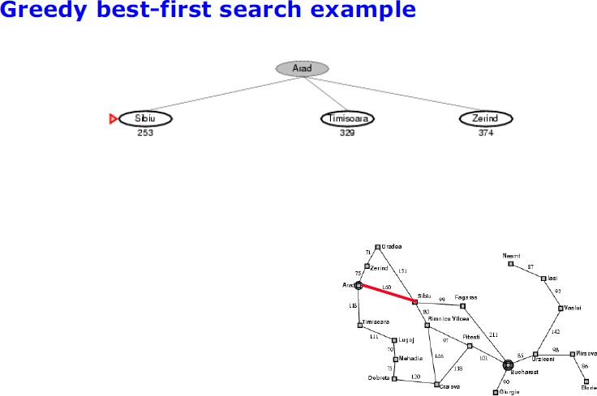

Slide 16
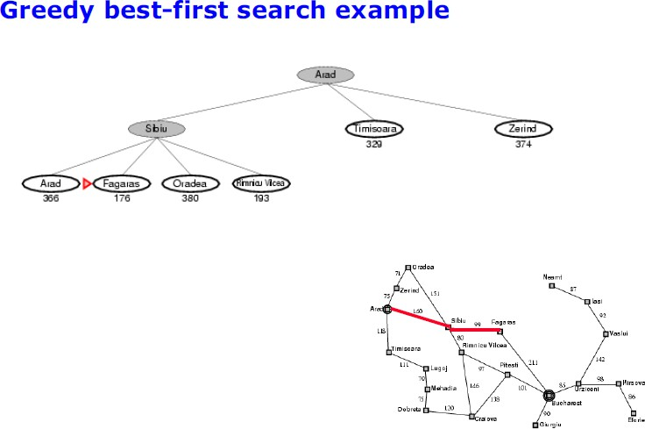

Slide 17
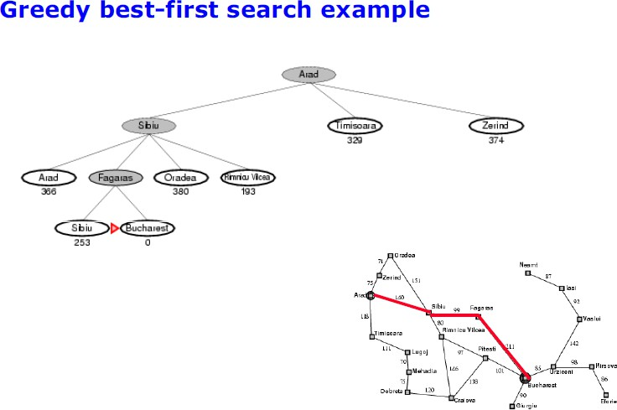

Slide 18
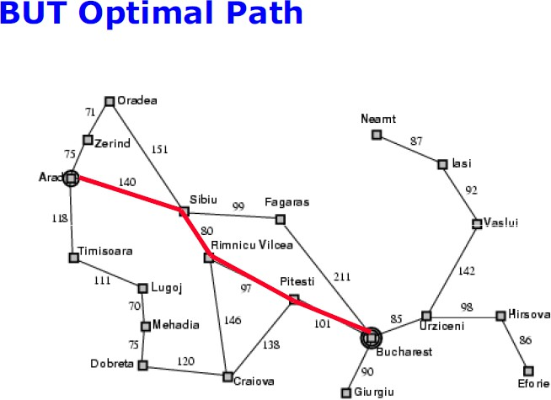

Slide 19
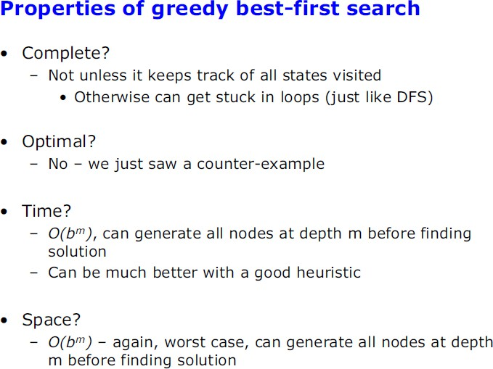

Slide 20
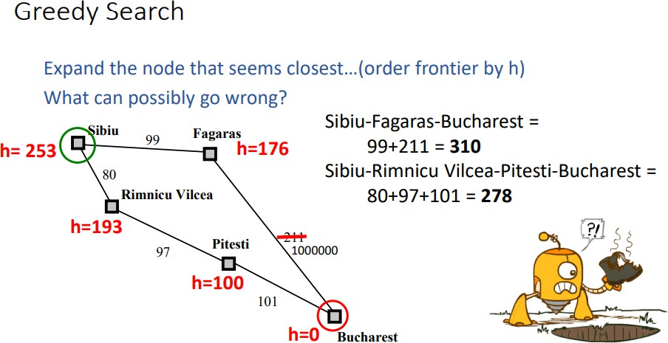

Slide 21

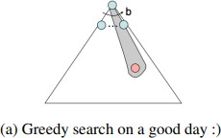
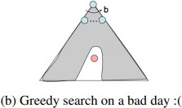
Strategy: expand a node that you think is closest to a goal state
Heuristic: estimate of distance to nearest goal for
each state
A common case:
Best-first takes you straight to the (wrong) goal
as seen in example.
Worst-case: like a badly-guided DFS

Slide 22
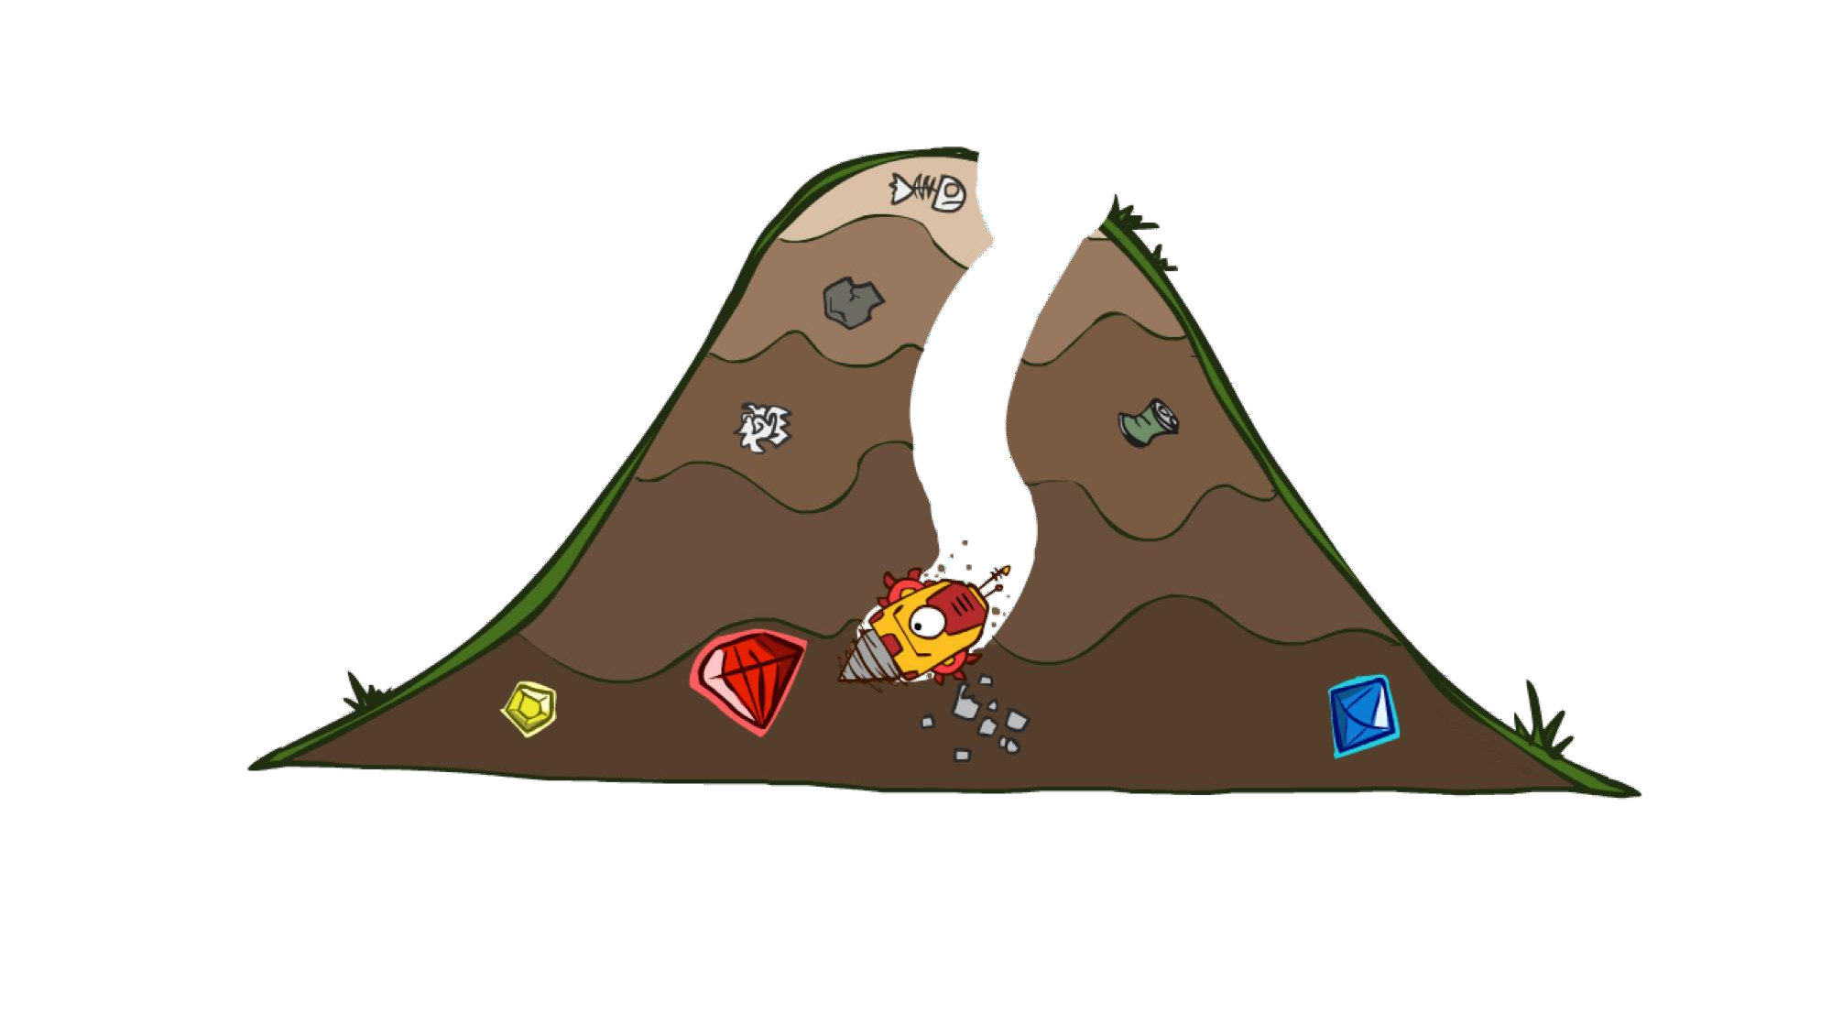


Slide 23
Estimation of future steps what would be the cost of them
Uniform-cost orders by path cost, or backward cost g(n)
Greedy orders by goal proximity, or forward cost h(n)
8
g = 0
S
h=6
e
h=1
g = 1 h=5
a
1
1
3
2
g = 2 h=6
g = 9 h=1
S
h=6
a
d
G
b
d
g = 4 h=2
e
1
h=5
h=2
h=0
c
h=7
1
b
h=6
g = 3 h=7
g = 6
h=0
g = 10
h=2
c
G
d
g = 12
h=0
A* Search orders by the sum: f(n) = g(n) + h(n)
G
Example: Teg Grenager

Slide 24
Should we stop when we enqueue a goal?
Adding Goal to Fringe
h = 2
2
A
2
S
h = 3
h = 0
G
2
B
3
h = 1
No: only stop when we dequeue a goal

Slide 25

h = 6
1
A
3
S
h = 7
G
h = 0
5
What went wrong?
Actual goal cost < estimated goal cost
We need estimates to be less than actual costs!

Slide 26


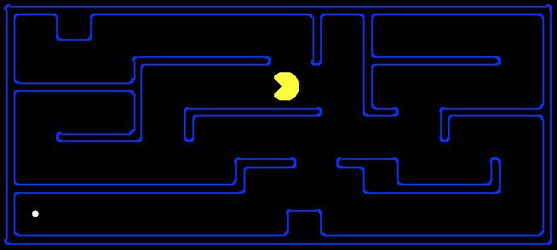
A heuristich is admissible (optimistic) if:if h(n) is never larger than h*(n), namely h(n) is always less or equal to true cheapest cost from n to the goal.
h(n) = estimated cost of the
cheapest path from the state at
∀𝑛
node n to a goal state.
where is the true cost to a nearest goal
Examples:
Is Manhattan distance here admissible
4
15
Coming up with admissible heuristics is most of what’s involved in using A* in practice.

Slide 27





Slide 28







Uniform-Cost
A*
b
b
…
…

Slide 29





Uniform-cost expands equally in all “directions”.
Start
Goal
A* expands mainly toward the goal, but does hedge its bets to ensure optimality.
Start
Goal

Slide 30
How to Construct an Admissible Heuristic
You identify relaxed version of the problem:
where one or more constraints have been dropped
problem with fewer restrictions on the actions
Robot: the agent can move through walls 8puzzle: (1) tiles can move anywhere
(2) tiles can move to any adjacent square
Result: The cost of an optimal solution in the relaxed problem is an admissible heuristic for the original problem

Slide 31
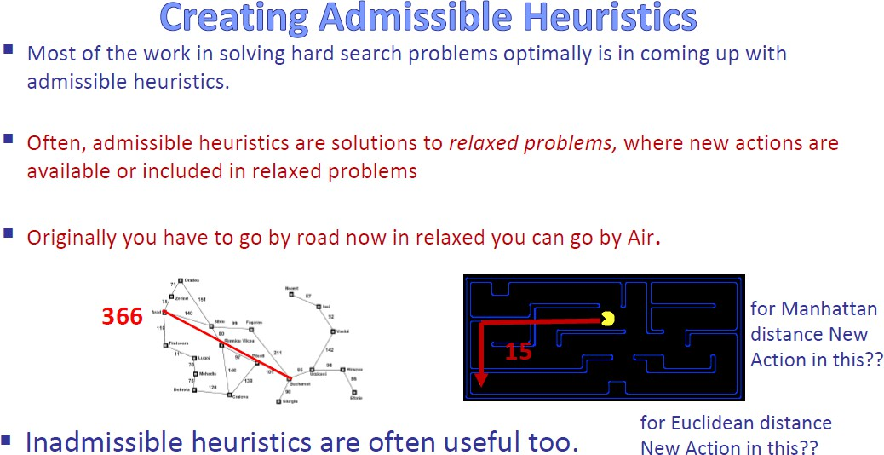

Slide 32
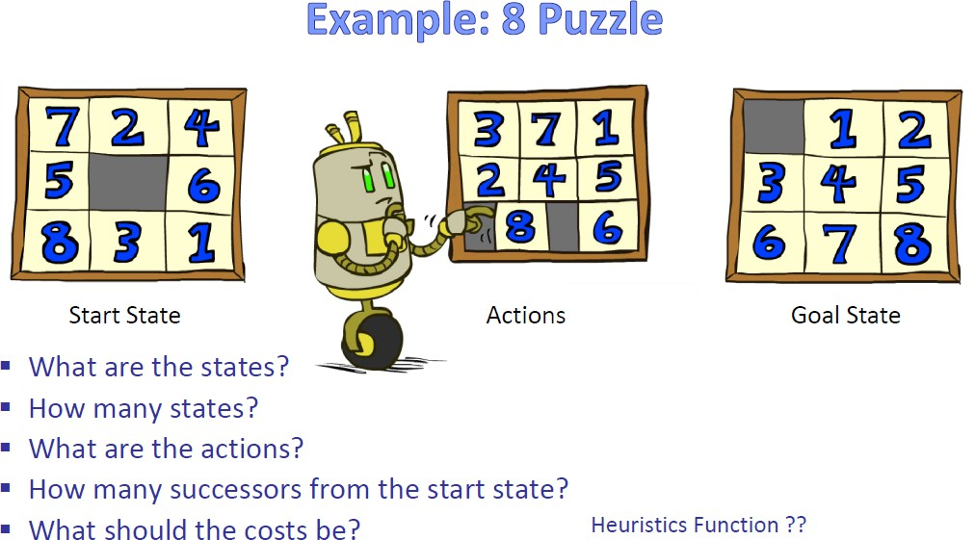
Every time we move a Tile cost is one
how far from final state .. And how we calculate this heuristics

Slide 33
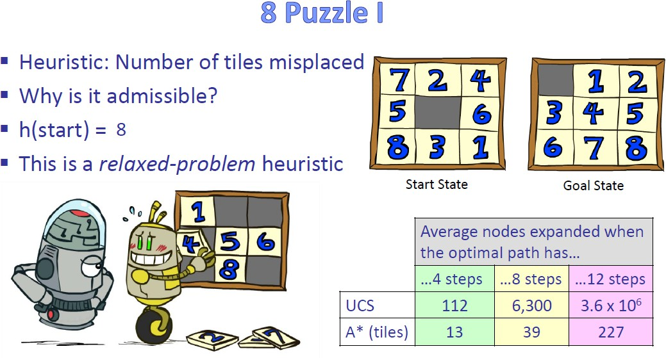
Option to grab a tile and move to original place

Slide 34
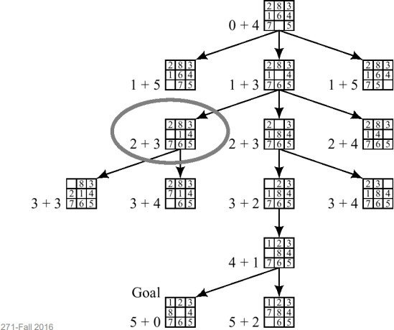

Slide 35
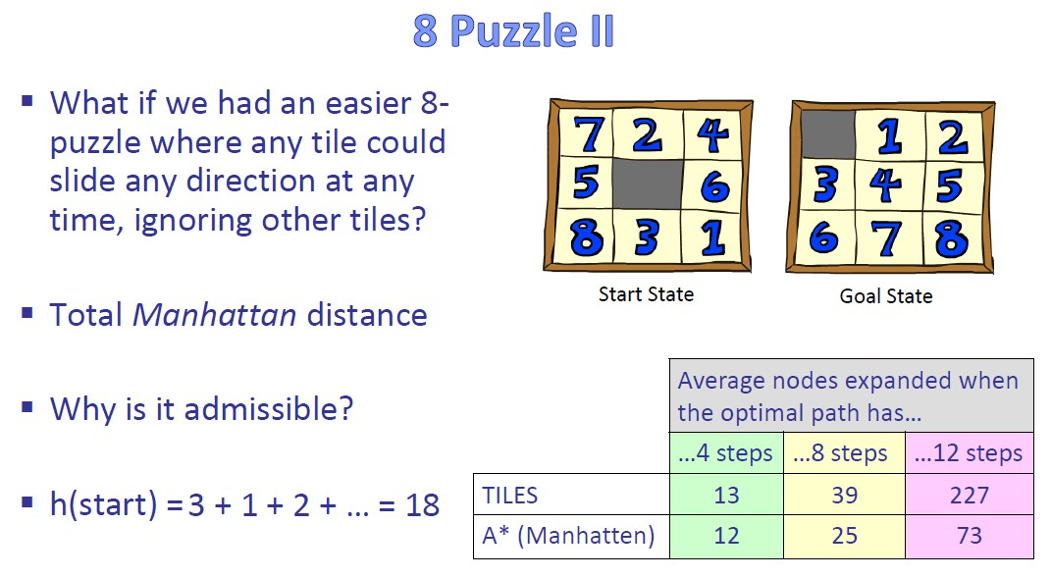
distance from current position to final position

Slide 36

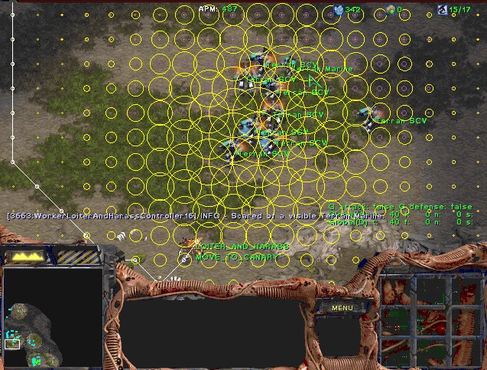
Video games
Pathing / routing problems
Resource planning problems
Robot motion planning
Language analysis
Machine translation
Speech recognition
…

